Slide 1

IoT Protocols
CoAP - Constrained Application Protocol
Lecturer: Dr. Bui Ha Duc
Dept. of Mechatronics
Email: ducbh@hcmute.edu.vn
1
Notes:
1

Slide 2
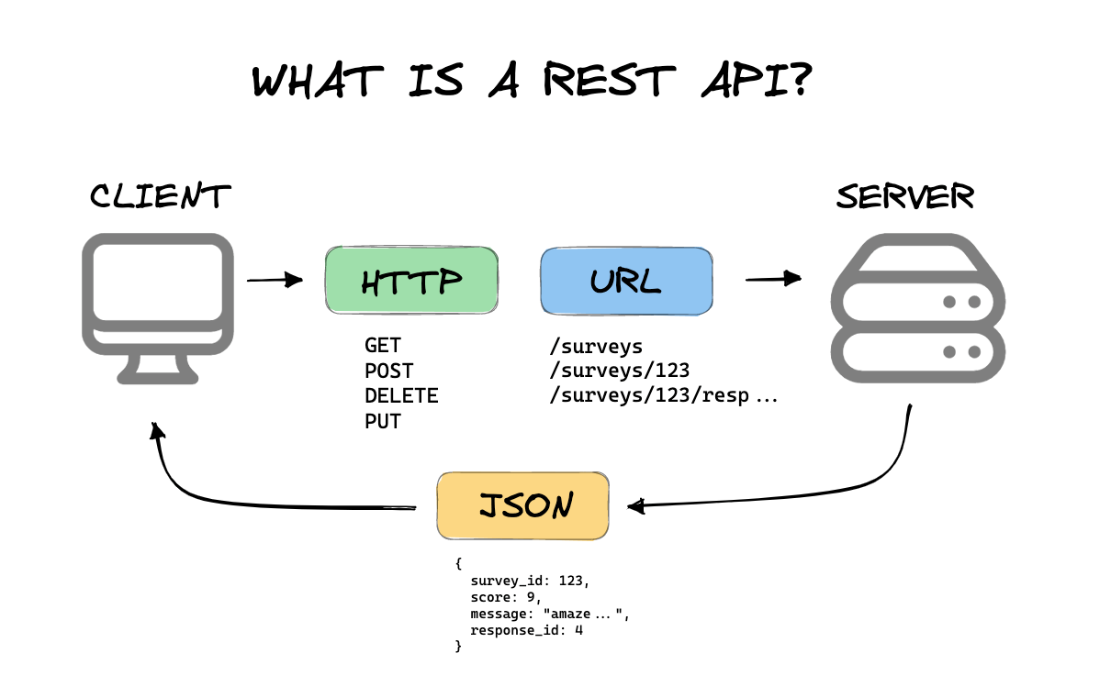
REST
RESTful Protocol:
REST stands for Representational State Transfer
REST is a architectural style, not a library or standard
An API that follows these constraints is called RESTful
  GET : Fetch a resource
  POST : Create a new resource
  PUT : Overwrite an entire resource
  DELETE : Remove a resource

Slide 3
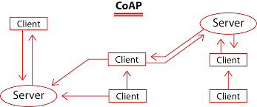
CoAP
CoAP is a specialized web transfer protocol designed for constrained devices and networks (IoT devices).
CoAP is essentially a light weight HTTP-like communication

Slide 4
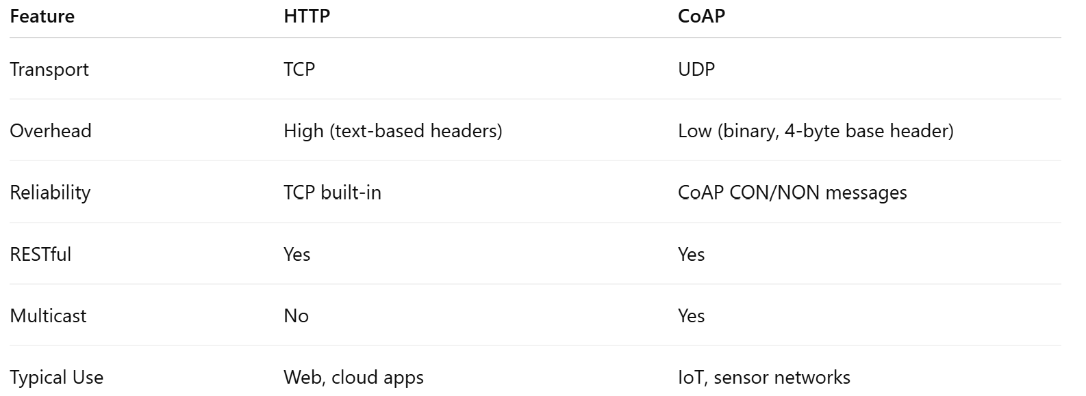
CoAP vs HTTP

Slide 5
CoAP vs MQTT
 | MQTT | CoAP
Architecture Model | Publish / Subscribe (Broker-centric) | Request / Response (Client / Server) + Observe
Transport Layer | TCP (Transmission Control Protocol) | UDP (User Datagram Protocol)
Header Overhead | Very small (~2 bytes minimal) | Small (~4 bytes minimal)
Network Topology | Star topology (All nodes talk through a Central Broker) | Point-to-Point, Device-to-Device (P2P), or Mesh
Device Interoperability | Loose coupling (Publishers & Subscribers do not know each other) | Tight coupling (Direct RESTful addressable endpoints)
RESTful Compatibility | No native support (Requires custom translation layers) | Native 1:1 mapping with HTTP (GET, POST, PUT, DELETE)
Device Discovery | Manual (Requires pre-configured Broker IP and Topic names) | Automatic via Multicast (GET /.well-known/core)
Power Consumption / Deep Sleep | Moderate (TCP connection upkeep & keep-alives consume battery) | Ultra-low (Sends quick UDP packet and returns to deep sleep immediately)
Reliability / Quality of Service | QoS 0 (At most once), QoS 1 (At least once), QoS 2 (Exactly once) | NON (Non-confirmable) and CON (Confirmable with application-layer ACK)
Security Protocol | TLS / SSL (over TCP) | DTLS (Datagram Transport Layer Security over UDP)
Primary Use Cases | Live dashboards, real-time telemetry streaming, centralized Cloud IoT platforms | Battery-powered sensors, Smart Home (Matter/Thread), Smart City (NB-IoT), P2P control

Slide 6
CoAP
CoAP can be use:
  Between devices on the same constrained network (e.g. low-power, lossy network)
  Between devices and general nodes on the internet
  Between devices on different constrained networks joined by the internet
CoAP is close to HTTP (Request / Response)
  REST model with GET, POST, PUT and DELETE verbs
  URIs, response code
  IP Multicast

Slide 7
CoAP features
  Asynchronous
  Low overhead
  Very simple to parse
  URI and content-type support
  Proxy and caching capacities

Slide 8
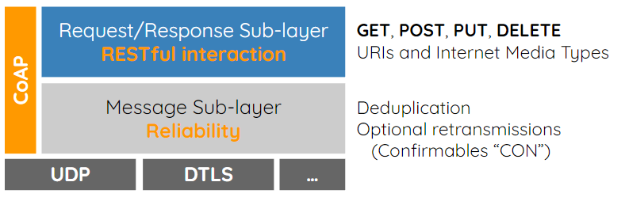
CoAP Protocols stack
CoAP protocol includes two different layers :
  Messages: deals with UDP and with asynchronous messages
  Request/Response: manages request/response interaction

Slide 9
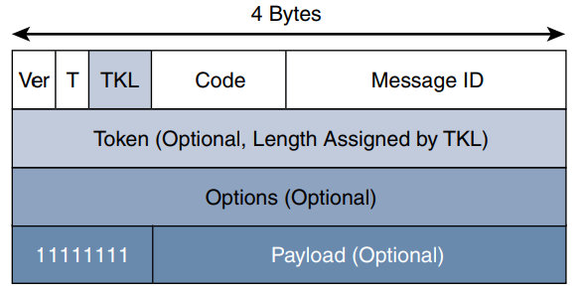
CoAP Message
CoAP Message Format
Ver: a 2 bit unsigned integer indicating the CoAP version
T: a 2 bit unsigned integer indicating the message type: 0 confirmable, 1 non-confirmable
TKL: 4 bit, specifies the size (0–8 Bytes) of the Token field
Code: the code response (8 bit length)
Message ID: the message ID expressed with 16 bit
Token: correlates requests and responses
Payload: CoAP application data

Slide 10
CoAP Message
CoAP supports four different message types:
Confirmable (CON)
  A Confirmable message is sent again and again until the other party sends an acknowledge message (ACK)
  The ACK message contains the same ID of the confirmable message (CON)
  If the server has troubles managing the incoming request, it can send back a Rest message (RST) instead of the Acknowledge message (ACK)
Non-confirmable (NON)
  messages that don’t require an Acknowledge by the server
Acknowledgment (ACK)
Reset (RST)

Slide 11
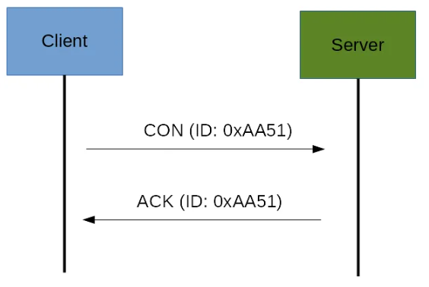
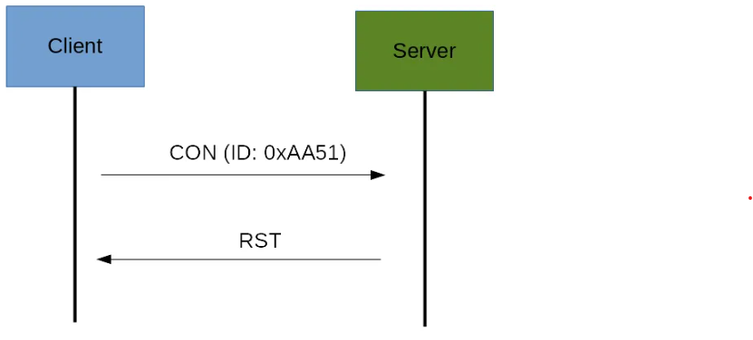
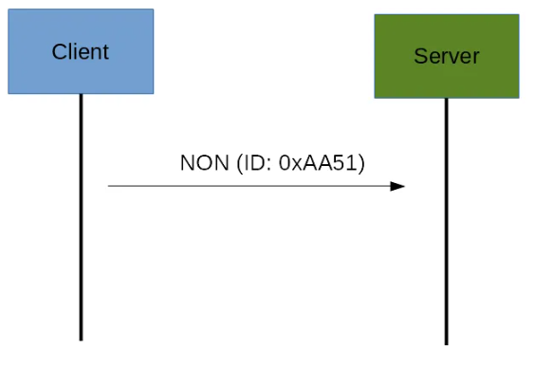
CoAP Message
Confirmable message
Non-Confirmable message

Slide 12
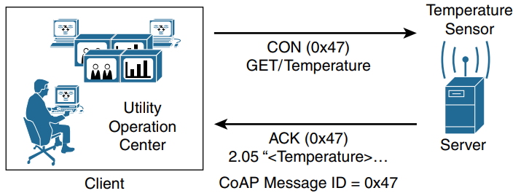
CoAP Request/Response Model

Slide 13
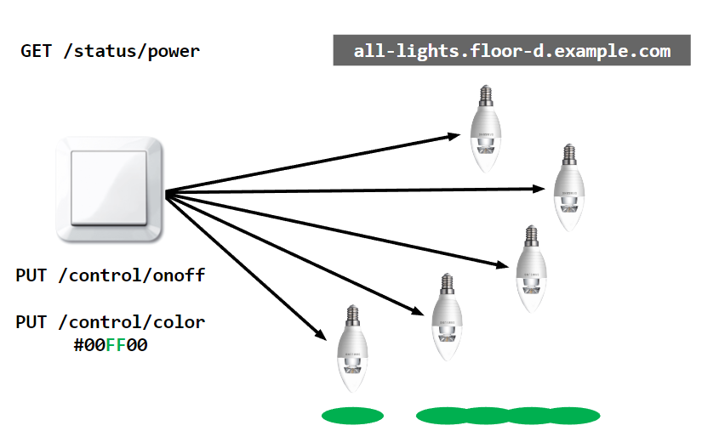
Example

Slide 14
CoAP Framework
libCoAP
Lightweight, high-performance C implementation of the CoAP
Website: https://libcoap.net/
Installation:
sudo apt update
sudo apt install libcoap3 libcoap3-bin libcoap3-dev
Compile
gcc code.c -o run $(pkg-config --cflags --libs libcoap-3)

Slide 15


CoAP Library
Eclipse Californium
Website:
  https://www.eclipse.org/californium/
Californium is a powerful CoAP framework targeting back-end services communicating
Californium is a Java implementation of RFC7252
Official Tutorial: http://goo.gl/LLQ03w
Aiocoap
aiocoap package is a Python implementation of CoAP
Github:
  https://github.com/chrysn/aiocoap
Official documentation:
  https://aiocoap.readthedocs.io/en/latest/

